Slide 1
WELCOME
THE PRESENTATION WILL BEGIN SHORTLY

Slide 2
Housekeeping
Thank-you for coming today!
Your cameras are off and you will be muted throughout this presentation.
If you have a question, please submit it in the Q&A box (which you can do throughout the presentation).
We will answer as many questions as we can at the end of the presentation.
We will house questions in an FAQ section on the Evergreen Festival business info page (you will receive the link after this presentation).

Slide 3
November 28 – December 21, 2020 Halifax, Nova Scotia

Slide 4
Landscape: Existing Markets/Events in HRM to complement (pre-COVID)
Dartmouth Handcrafters (late Oct)
Christmas at the Forum (early Nov)
Saltscapes Harvest Greets the Holidays (early Nov)
Christmas Craft Village Exhibition Park (early Nov.)
NSDCC Christmas Craft (mid Nov)
Dal Christmas Craft Fair (late Nov)
Christkindl Market (early Dec)
Halifax Crafters Market (early Dec)
Glow Gardens
Parade of Lights (Nov)
Parade Square Tree Lighting (Nov)
Halifax Lights Festival (Nov-Dec)

Slide 5
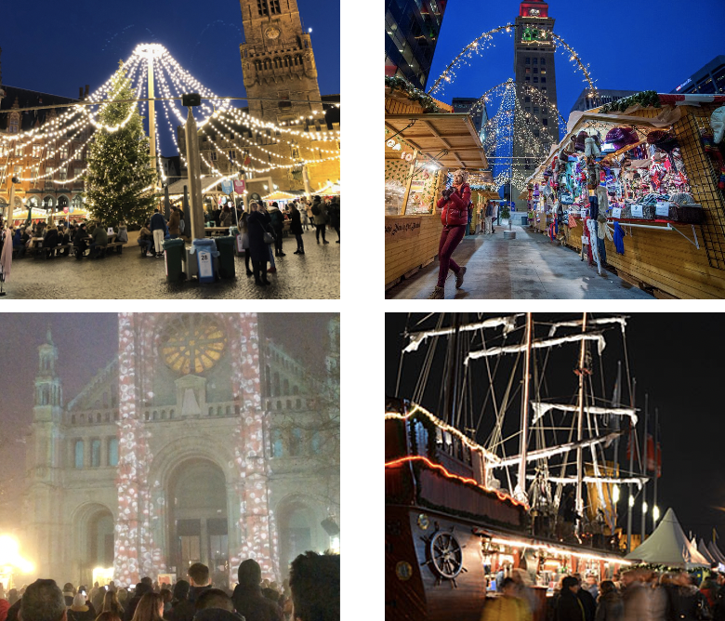
European Holiday Markets
GERMANY: Cologne Christmas Market Nov 25 - Dec 23
BRUGES: Winterglow Nov 22 – Jan 5
BRUSSELS: Winter Wonders Nov 29 – Jan 5
ANTWERP: Christmas Market Dec 7 – Jan 5
STRASBOUR: Christmas Market in France Nov 22 - Dec 30

Slide 6
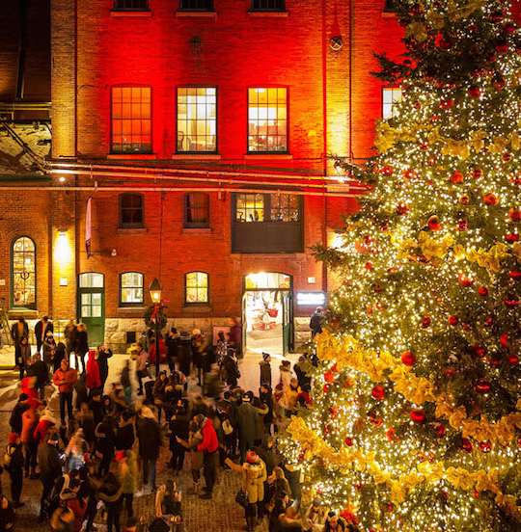
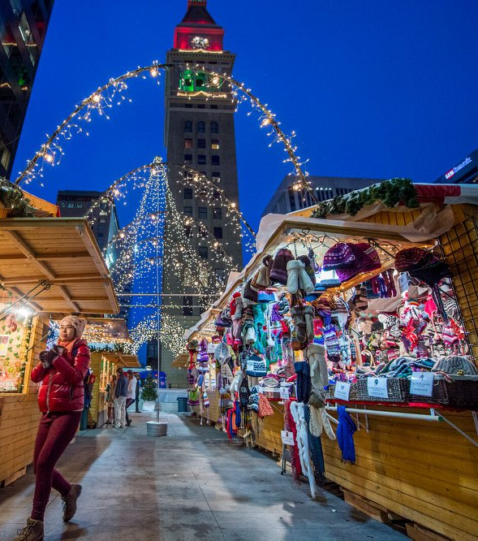
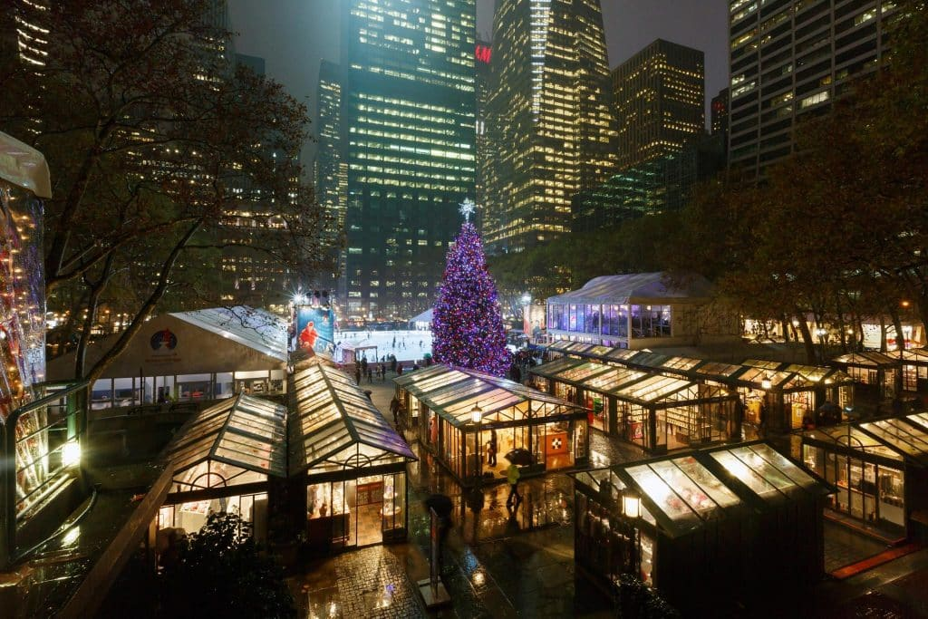
Canada & US Holiday Markets
TORONTO: Christmas Market at the Distillery Nov 14 – Dec 22
NEW YORK: Winter Village at Bryant Park Oct 31 – Mar 1
DENVER: The Denver Christkindl Market Nov 22 – Dec 23

Slide 7
Nov. 28 – Dec. 21 (Small Business Saturday to Winter Solstice)
Halifax waterfront & downtown
Wednesdays & Thursdays: 4 – 10pm
Fridays & Saturdays: Noon – 10pm
Sundays: Noon – 6pm

Slide 8
Why now?
More important than ever to support small, local businesses
Patio season extension
Safe: outdoor & dispersed
Protocols set overall and practiced by each business
Virtual tie in to bring entertainment to homes (in Nova Scotia & beyond), but also to businesses
Consumer confidence builder, but also supports mental health and other important outcomes

Slide 9
Festival Features:
Evergreen Village (Halifax waterfront) Festival Stage Holiday Market (24 Chalets) Light Experiences
Evergreen Festival of Lights Collection of Light Installations & Light Experiences
Evergreen Patios, Events & Programming Sip & Savour the sights & support businesses/organizations
Evergreen Packages & Getaways Nova Scotia/Atlantic Region

Slide 10
Festival of Lights
An outdoor, walkable trail of lights stringing together downtown to the waterfront stretching from:
Spring Garden Road
Peace and Friendship Park
Argyle Street
Grand Parade
Halifax waterfront from Historic Properties to Halifax Seaport
Charitable Organization Collaborations
Corporate Creations with Community
Storefront Displays

Slide 11
Let’s start a new tradition, together.

Slide 12
Marketing Plan Components
Evergreen Festival Website (evergreenfestns.com)
Evergreen Festival Social Media Channels (@evergreenfestns)
Partner Social Media Strategy
PR Plan – press release, interviews, etc.
Marketing Collateral
Paid Marketing Campaign ~$100K in media
Within the HRM and throughout the Maritimes
Content Capture (photography, b-roll, etc.)
FESTIVAL DATES: Nov 28 – Dec 21

Slide 13
Target Key Dates
FESTIVAL DATES: Nov 28 – Dec 21
TEASER
Oct 21 – Nov 8
AWARENESS
Nov 12 – Nov 22
ENGAGEMENT
Nov 23 –Dec 21
- Website Landing Page goes live
- Social Media begins
- Website: event info live
- Social Media ramps up
- Partner Social Media begins
Paid Media begins
- Completed Website: Restaurant, Hotel, Retail info*
- Social Media continues
- Partner Social Media continues
Paid Media continues
PR begins
Collateral distributed
Wayfinding Signage goes up
*Info from restaurants & hotels: Nov 3

Slide 14
Food and Beverage Plan:
Introducing Evergreen Soups & Sips: Warm up with yummy bevies and soups on-the-go as you savour the sights and sounds of the Evergreen Festival.
Participation Requirement:
Create a festival-inspired beverage and/or soup.
Will be promoted as an on-the-go program to encourage movement around the festival (but dine-in is an option as well).
Be creative - give it a memorable name!
Send us a nice photo for the website/social media.
DEADLINE TO SUBMIT YOUR OFFER: NOV 3
Notes:
Promotion:
Featured on the Evergreen website
Provide sticker with logo for your take-out cups/bowls
Promoted via social
May be used in marketing material

Slide 15
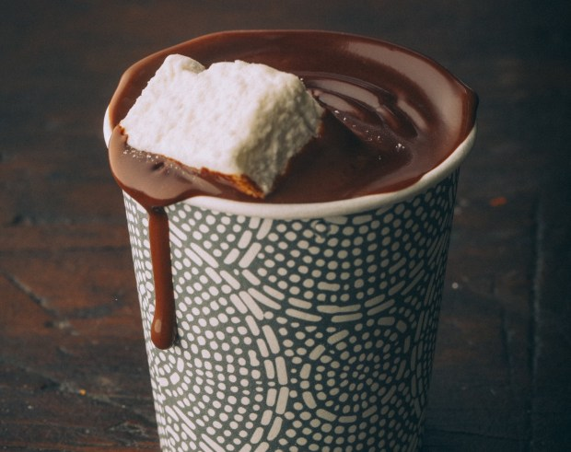
What’s in a Name?
​HO HO Hot Chocolate
EverGREEN Tea
Hot THAWcolate
Christmimosas
East Coast Coffee
Halifax Fogilicious
Evergreen Eggnog
Polar Punch
Mulled Cider with a Twist
Ice Rink
Festive Fruit Punch
EverGREEN Goddess soup
Best EVERgreen Seafood Chowder
“Hey Hot Stuff” Spicy Soup
Blissful Butternut Squash
Winterful White Bean Soup
Fill Your Belly Beef & Potato Soup

Slide 16
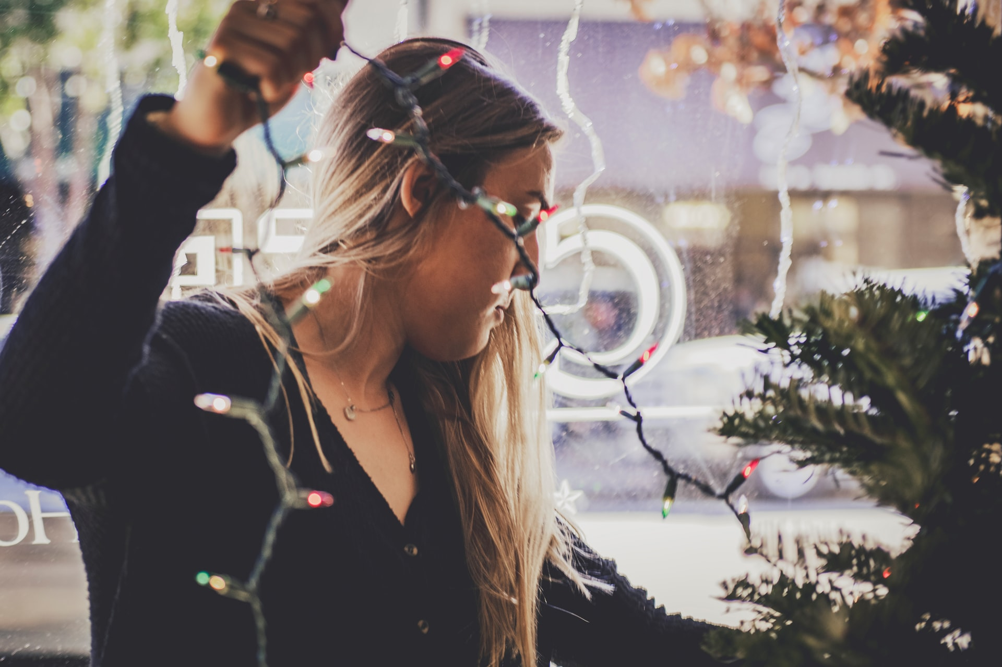
Create an EXPERIENCE!
LIGHTS! LIGHTS! LIGHTS!
Create warmth (literally and figurately!)
Decorate your patio (if you have one)
Play festive music
Put up Evergreen Collateral in your windows

Slide 17
Hotel Packages
Savour all that Evergreen Festival has to offer by staying a single night or the entire week-end with one of these festive hotel offers!
Participation Requirement:
Create a festive hotel package
Create an offer with your onsite restaurant OR
Partner with a restaurant or provide a gift card
Offer gift with stay (Festive local package)
DEADLINE TO SUBMIT YOUR OFFER: NOV 3

Slide 18
Retail Involvement
The Evergreen Festival’s key tie to retail will be in support of Shopping Under the Stars on Dec 4th.
For more info on how to get involved, reach out to:
Scott MacKendrick, Spring Garden Area Association
→ scott@springgardenarea.com
Allana MacDonald Mills, Downtown Halifax Business Commission
→ allana@downtownhalifax.ca
Additional ways you can get involved:
Make your store/storefront festive!
Engage with the Festival’s social channels @EvergreenFestNS
Let us (and shoppers!) know if you have extended hours or special promos by using the hashtag #OpenforEvergreen

Slide 19
Why Support Evergreen?
Encourage safe movement along the Waterfront and downtown core Join your community in supporting and celebrating our local economy, culture, and one another Increase visibility for your business during the holiday shopping season Incremental sales for existing and pop-up businesses and operators Your support helps build a case to make this an annual event Be a part of making the city feel alive!

Slide 20
Now what?
Expect and email following this meeting with:
Copy of presentation
Link to Evergreen Festival Info Page
Ability to register (restaurant, hotel) – DEADLINE NOV 3!
Expect ongoing communications and updates
Follow the Evergreen Festival social media channels. (@evergreenfestns)
Please support the festival via your inclusion and your social channels.
Encourage your neighbour to participate and be creative!

Slide 21
Let’s start a new tradition, together.

